Slide 1


COURSE MATERIAL
Course : 23CSC04 – Principles of Compiler Design
Module : 2 - Semantic Analysis and Intermediate Code Generation
Topic : Type Checking: Type system; Type checker; Type expression; Type conversion
Faculty:G.Vidyasree
www.skcet.ac.in

Slide 2
MODULE II Semantics analysis and Intermediate Code Generation 15 Hours Introduction to Semantics Analysis - Type Checking. Intermediate Code Generation: Intermediate Languages- Declarations - Assignment Statements - Boolean Expressions - Case Statements - Back patching - Procedure Calls. Run Time Environments: Source Language Issues - Storage Organization- Storage Allocation strategies

Slide 3
Introduction to Semantic Analysis
This phase checks the source program for semantic errors and gathers type information for subsequent code generation phase.
An important component of semantic analysis is type checking.
Compiler checks that each operator has operands that are permitted by the source language specification.

Slide 4
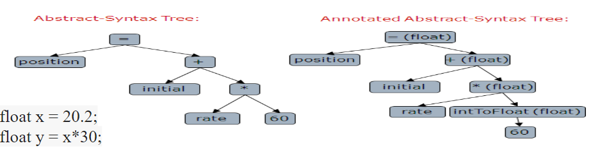
Semantic analysis inserts a conversion from integer to real

Slide 5
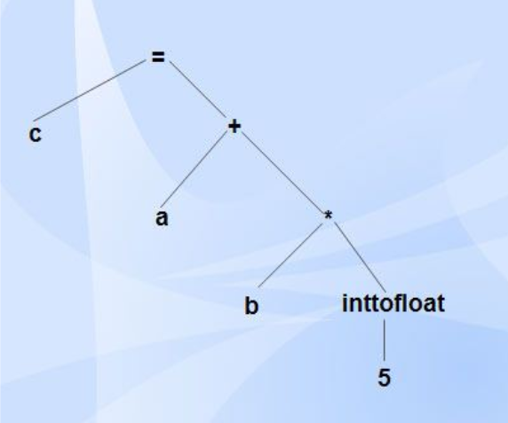

Slide 6
Type Checking
Type checking is an important part of semantic analysis where compiler makes sure that each operator has matching operands.
Errors
Compiler must check that the source program follows both the syntactic and semantic conventions of the source language.
Static checks - reported during the compilation phase.
Dynamic checks - occur during the execution of the program.

Slide 7
Semantic Errors
Errors recognized by semantic analyzer are as follows:
Type mismatch
Undeclared variables
Reserved identifier misuse
Static Checks
Type checks: A compiler should report an error if an operator is applied to an incompatible operand.
Flow of control checks: Places for transfer of control should be specified.
Uniqueness checks: An object must be defined exactly (like the type of an identifier, statements inside a case/switch statement.)
Name Related checks: Same name must appear two or more times.

Slide 8
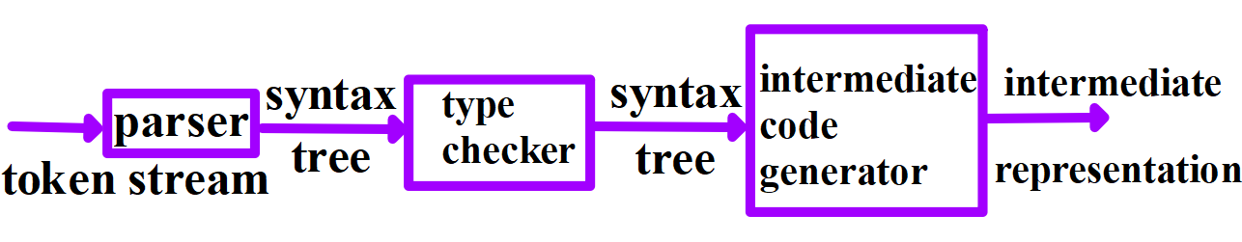
Position of Type Checker

Slide 9
Type Systems
Design of a type checker for a language is based on the information about the syntactic constructs in the language.
Each expression has a type associated with it.
Types are either basic or constructed.
Basic types are atomic with no internal structure as far as the program is constructed.
Pointers, arrays, functions, structures can be treated as constructor types.

Slide 10
Type Expressions
Type expression is either a basic type or is formed by applying an operator called type constructor to other expressions.
A basic type is a type expression.
Basic types are boolean, char, integer, real.
Type expressions may be named, type name is a type expression.
Type constructor applied to a type expression is a type expression.
Constructors include:
Arrays
If T is a type expression, then array(I, T) is a type expression denoting the type of an array with elements of type T and index set I.

Slide 11
Example
Var A :array[1...10] of integer;
Associates the type expression array(1..10,integer) with A.
Products
If T₁ and T₂ are type expressions, then their cartesian product T₁ x T₂ is a type expression .
Records
Record type constructor will be applied to a tuple formed from field names and field types.

Slide 12
Example
type row=record
address: integer;
end;
var table: array [1..10] of row
declares the type name row representing the type expression
record((address x integer) x(lexeme x array(1...15,char)))
and the variable table to be an array of record of this type.
Pointers: If T is a type expression, then pointer(T) is a type expression.
var p: row
declares variable p to to have type pointer (row)

Slide 13
Functions: Functions in a programming language map a domain type D to a range type R. Often, for implementation reasons, there are limitations on the types a function can return.
Type Systems
Type system is a collection of rules for assigning type expressions to the various parts of a program.
Type checker implements a type system.
Type of an array includes the index set of an array, so a function with an array argument can only be applied to arrays with that index set.

Slide 14
Static and Dynamic Checking of Types
Sound type system eliminates the need for dynamic checking for type errors.
A language is strongly typed if its compiler can guarantee that the programs it accepts will execute without type errors.
E.g. array bound checking.
Error Recovery
Type checking has the potential for catching errors in programs, it is important to do something when an error is discovered.
Inclusion of error handling may result in a type system that goes beyond the one needed to specify correct programs.

Slide 15
Specification of a simple type checker
Type checker can handle arrays,pointers, statements and functions.
A Simple Language
Type of each identifier must be declared before the identifier is used.
Type checker is a translation scheme that synthesizes the type of each expression from the type of its sub-expressions.
P --> D; E
D--> D; D | id: T
T--> char | integer | array[num] of T | * T
E--> literal | num | id | E mod E | E[E] | E*
Base Types: char, integer, type-error

Slide 16
Translation Scheme
P --> D; E
D--> D;D
D--> id :T { addtype(id.entry,T.type);}
T--> char {T.type= char;}
T--> integer {T.type=integer;}
T🡪T₁ {T.type=pointer(T₁.type);}
T--> array[num] of T₁
{ T.type =array(1..num.val, T₁ type); }

Slide 17
Type Checking of Expressions
Semantic rules
E--> literal { E.type=char;}
E--> num { E.type =integer;}
E--> id { E.type =lookup(id.entry);}
E--> E₁ mod E₂ { E.type =If (E₁.type ==integer) if (E₂. Type ==integer) integer; else type-error;
E--> E₁[E₂] { E.type=if ((E₂.type==integer)&& (E₁.type==array(s,t)) t; else type-error;}
E--> * E₁ { E.type = if (E₁.type ==pointer(t)) t else type-error;
Literal and num have type char and integer respectively.

Slide 18
Type Checking of Statements
S--> id=E { if (id.type==E.type) void; else type-error;}
S--> if E then S { if (E.type==boolean) S_1.type; else type-error;}
S--> While E do S { if (E.type==boolean) S_1.type; else type-error;
S--> S; S; { if (S_1.type==void) if (S_2.type ==void) void; else type-error;}
Type Checking of Functions
E--> E(E)
T--> T₁’ -> ‘T₂ { T.type = T₁.type -> T₂.type}
E--> E₁(E₂) {E.type = I f ((E₂.type ==s) && (E₁.type == s--> t)) t; else type-error;
E1=5=E2
E1(E2)

Slide 19
Equivalence of type expressions
Testing the structural equivalence of two type exp s and t
Function sequiv(s,t): boolean
Begin
if s and t are of the same basic type then
return true
else if s=array(s1,s2) and t = array(t1,t2) then
return sequiv(s1,t1) and sequiv(s2,t2)
else if s=s1Xs2 and t = t1Xt2 then
return sequiv(s1,t1) and sequiv(s2,t2)

Slide 20
else if s=pointer(s1) and t = pointer(t1) then
return sequiv(s1,t1)
else if s=s1🡪s2 and t = t1🡪t2 then
return sequiv(s1,t1) and sequiv(s2,t2)
else
return false
end
Array type checking can be reformulated as
else if s=array(s1,s2) and t = array(t1,t2) then
return sequiv(s2,t2)

Slide 21
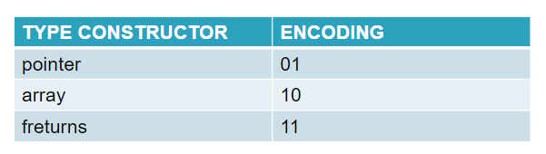
Encoding of Type Expressions
Types
Char
freturns(char)
pointer(freturns(char)
array(pointer(freturns(char)
BASIC TYPE | ENCODING
Boolean | 0000
Char | 0001
Integer | 0010
Real | 0011

Slide 22
TYPE EXPRESSION | ENCODING
Char | 000000 0001
Freturns(char) | 000011 0001
Pointer(Freturns(char) | 000111 0001
Array(Pointer(Freturns(char) | 100111 0001

Slide 23
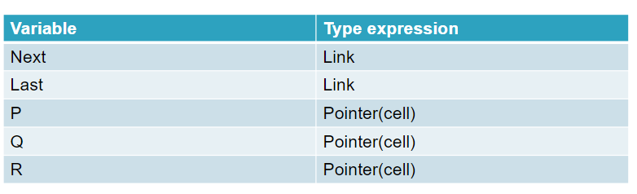
Names for type expression
Type link =* cell;
Var next: link;
Last: link;
P: *cell;
Q,r= *cell;

Slide 24
Type Conversions
Type Conversions can be:
explicit (casts) if the programmer must write something to cause these conversions.
implicit (coercions) if done automatically by the compiler.

Slide 25
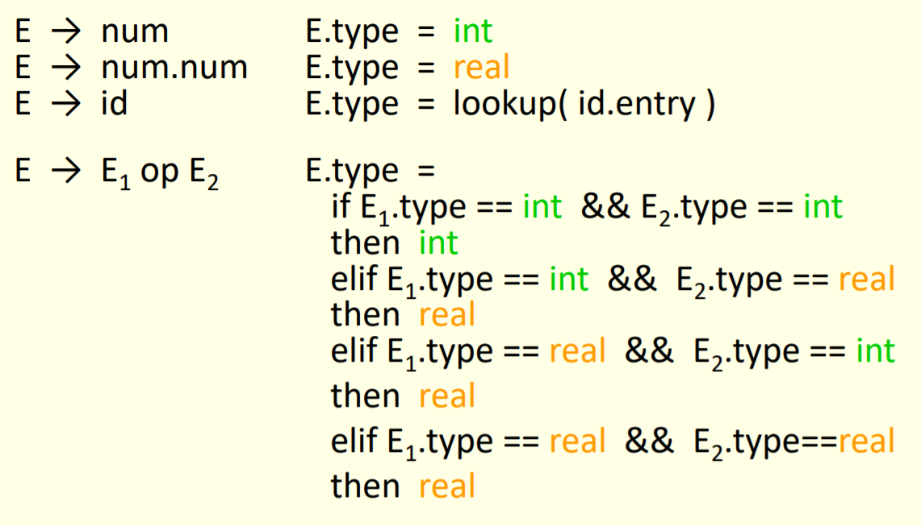

Slide 26


